Slide 1
Smart Homes
COMPUTER LITERACY

Slide 2
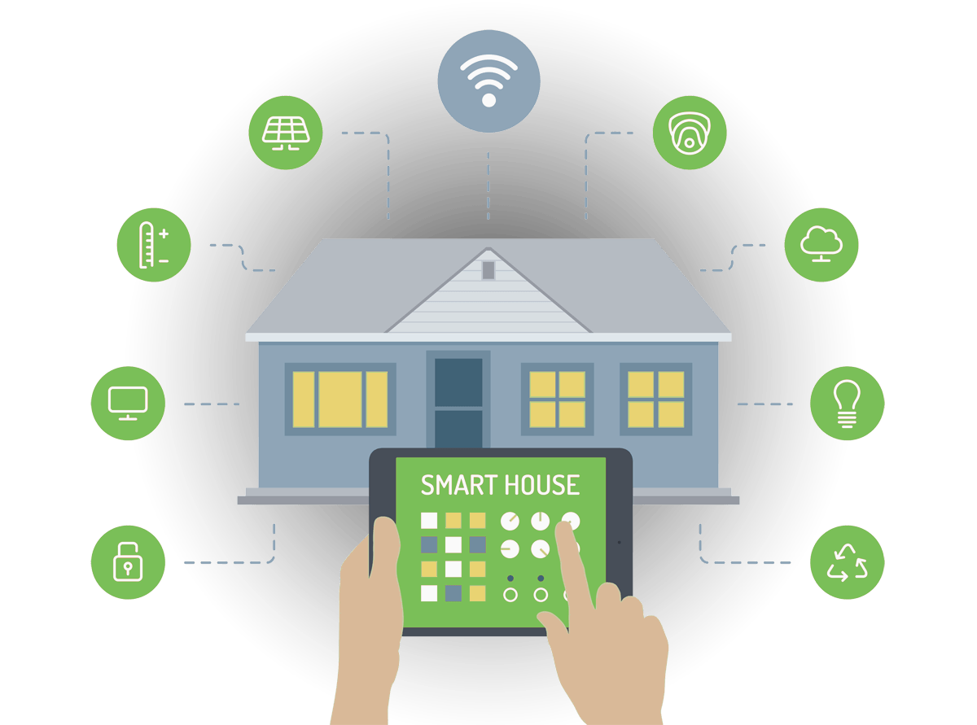
What is a Smart Home?
Smart home: a dwelling incorporating a communications network that connects the key electrical appliances and services, and allows them to be remotely controlled, monitored or accessed.
Elements of a smart home:
Communication network: wire, wireless, or mixed
Intelligent control: system management
Home automation: relevant components and systems

Slide 3
Major Areas of Application
Home appliances
Oven
Fridge
Environment
Lighting
HVAC
Water
Health care
care for the elderly and disabled
Security
person recognition
alarms

Slide 4
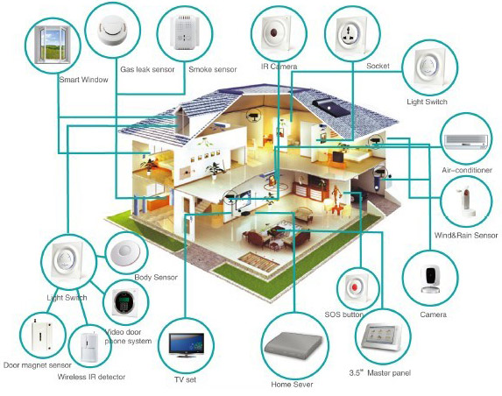
Smart Home System

Slide 5
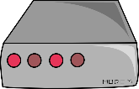



Architecture for smart home system
Application-specific server/database
internet

Slide 6
Smart home products that are currently available

Slide 7
Smart lightbulbs
Change color or brightness based on
Remote
Cue – 8pm every night; on sunrise/sunset
Upon receipt of text

Slide 8
Smart mirrors

Slide 9
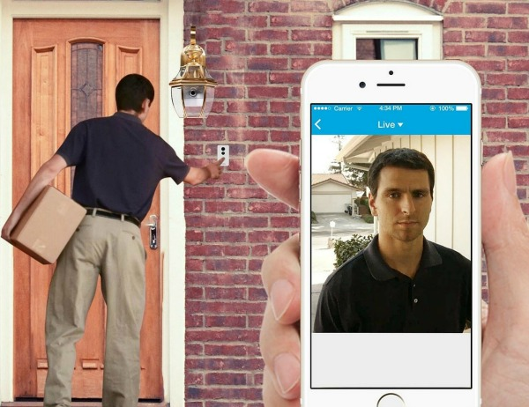
Smart locks and doorbells

Slide 10
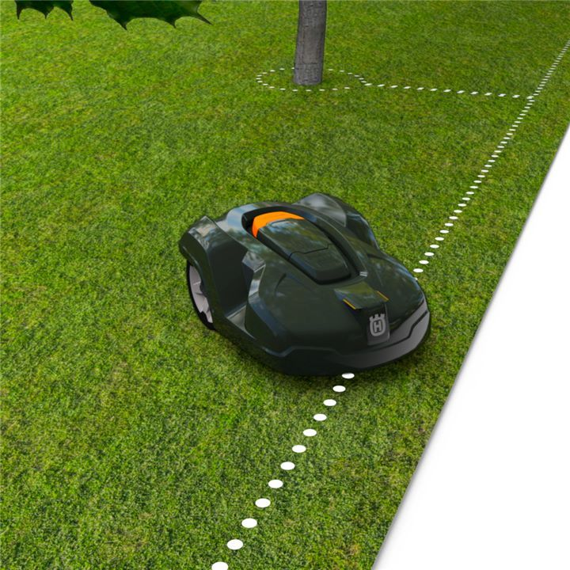
Smart Lawnmowers

Slide 11
Hub: cooperating devices
Interacts with multiple devices and can be programmed with a set of rules.
When someone leaves, automatically
turn off lights, heater/AC
lock door
set off alarm if motion sensor is activated
When smart watch indicates you woke up, automatically
Turn on lights
Start brewing coffee
Automatically be notified if there’s a water leak in the basement

Slide 12
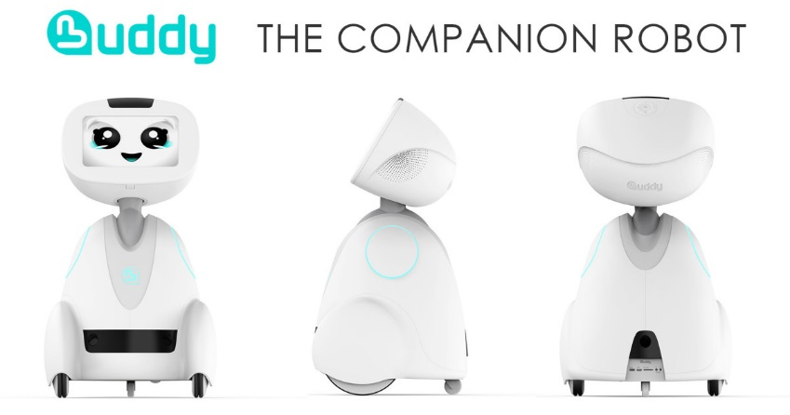
Future directions
Personal assistant robot
Integration with self-taught AI for predicting automation
Must have increased security of software and devices

Slide 13
Smart Home Benefits
Control at your fingertips
Customization
Reducing cost of home-security
Comfortable living
Accessibility
Reduced energy wastage

Slide 14
Smart Home Challenges
Reliability
Cost
Device variety
Privacy and security issues
Safety
Learning curve

